Slide 1

LaunchCode Liftoff
Class 5
Kevin Beashore
1/13/2022
Slides adapted from: Hank Dedona

Slide 2
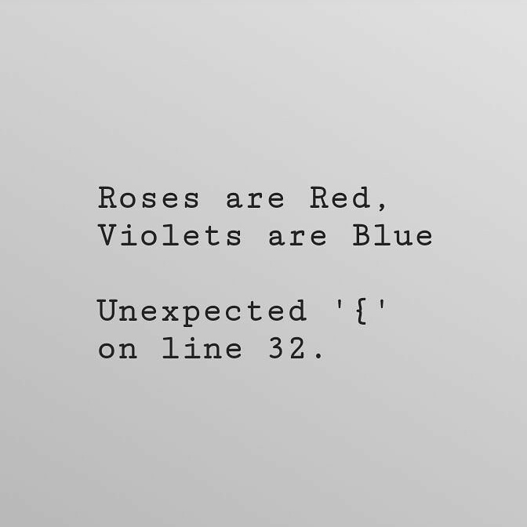
Agenda
Timeline
Lecture:
Liftoff Completion Requirements
Additional fun topics:
REST API – you have been doing this
SQL v. NoSQL
Cloud
DevOps
Microservices v. Monolith (CAP Theory)

Slide 3
Liftoff Project Timeline
Address Feedback & Technical Questions
Next Features & Interviewing
Class 5
Class 7
Class 6
Class 8
Next Features & Mock Interviews
Final Review
Notes:
More open format towards the end, start adding features
Final project review - May not be complete, but a good start

Slide 4
What does it take to finish LiftOff?
Things needed to be up to date with assignments:
Project Review 1
Live Coding Module (Today)
LaunchCode Resume
Demographic Form (if not already completed)
Assignments to be completed for LiftOff in the coming weeks:
Behavioral Interviews (Mock Interviews) critical functional first
January 26th + 27th if you cannot make the 26th
Final Project Review
LiftOff to Ready for Placement Survey
Notes:
Resume Aug 21st

Slide 5
LiftOff Fun Topics
Note: All these things are items that from one lecture you will not be proficient in. This is mainly to introduce you to other technologies for you to explore after graduating and could be something else you are interested in!

Slide 6
REST endpoints
REST – Representational State Transfer
Some interviewers will ask you to define REST, a lot of people fail on this, they can provide examples, but fail to explain what it is.
REST in its simplest form is a design paradigm for web services built on top of HTTP.
HTTP Verbs
GET
POST
PUT/PATCH
DELETE
RESTful services should be client-server based stateless web services usually using JSON as the data type.
Notes:
You guys have all been doing this. When we use @Controller(‘someResource’) and the @post or @getMapping(‘blah’) we are creating REST endpoint. Normally, these endpoints have resources inside the path like @Controller(‘members’) and then internal to that controller we would have a @getMapping(‘/{id}’) with a dynamic id to support getting one given member.
They follow HTTP verbs standards
* Get for simply getting a given resource
Post for creating a new resource
Put is for updating and replacing a resource | Patch is for updating and modifying a resource
Deleted is for deleting a resource
There are best practices around each when creating these endpoints, a lot of this depends on the technology you are using. When returning errors from these endpoints, or really, any endpoints it’s standard to follow error status codes in the following way:
1xx – hold on I’m working
2xx – request returned an ok response
3xx – go away redirects
4xx – the request is messed up in some way
5xx – server errors, something is wrong the the service you are calling

Slide 7
Databases SQL vs NoSQL
SQL databases are called relational DBs and follow A.C.I.D. Whereas NoSQL are called Non-relational or distributed databases and follow B.A.S.E.
SQL databases are table-based, while NoSQL databases are document, key-value, graph, or wide-column stores.
SQL has a static schema vs NoSQL has a dynamic schema
NoSQL works best for companies that are going through rapid growth stages or those with a lot of unstructured data
Many companies are starting to use both together
Notes:
SQL DB were the norm and then No SQL database is were created to address limitations of relational database management systems. Often times, you will hear NoSQL differs to SQL because it’s not relational and that’s a little confusing because it’s in a database and the data is still relational what they really mean is that you can’t join separate tables or group data together by joins. The relationships in a no SQL database depends on the type of no SQL database you are using whether it’s a document, key-value, graph or column DB. But make no mistake there is relationships between the data in either case it just differs on how that relationship is.
ACID is an acronym determined from four properties implemented and rational database management systems BASE is an acronym for properties common in no SQL database.
A is for at-o-miss-ity which implies describe a unit that cannot be further divided. C is for consistency this is known as a strict consistency in other words a transaction does not leave a database in a state that violates the integrity of the data. I is for isolation, isolated transactions are not visible to other users until that transaction is complete
BASE
SQL is more idempotent because of it’s static schema which basically means a given input will generally always result in the same output. NoSql dynamic schema allows a given input to result in a different output and is there for less idempotent.

Slide 8
Datastores (bases) SQL vs NoSQL
SQL | NoSQL
MySQL | Document DBs: MongoDB & CouchDB
Oracle | Key-Value: Redis & DynamoDB
Microsoft SQL Server | Graph: Neo4J
PostgresSQL | Columnar: HBase
Notes:
Here are some examples of SQL and NoSQL DBs. As you can see not all NoSQL DBs are structured in the same way as stated in the previous slide this just denotes how each NoSQL interfaces with data respectfully.

Slide 9
Public Clouds
You’ve probably heard of them before, AWS, Azure, GCP, etc.
These public clouds provide many services at various layers including
IAAS – Infrastructure as a service – Basic building blocks of IT – Servers, network, data storage, etc.
PAAS – Platform as a service – Hardware and OS, allows for focus on deployment. No need to worry about OS level concerns (patches, etc)
SAAS – Software as a service – Completed product that can be run and is managed by the cloud provider. E.g. – Web-based email
The layer of public cloud services you use will depend on your needs, as you go from IAAS -> SAAS, your low-level control disappears.
https://aws.amazon.com/types-of-cloud-computing/
Notes:
AWS, Azure, GCP….These are the public clouds many companies are using to run their businesses!
Why use them well a little history here:
Back in the day, all web services were deployed to purchased, physical hardware as monolith servers/applications.
This was very expensive and left a lot of unused hardware as usually only 1 application was running per server.
Plus a company would have to buy a lot of servers if you expected a lot of traffic to your site and you had to buy enough to handle peek times which means you are paying for all the hardware for the peek time but you are not actually using it.
Insert Public cloud providers to help!
Using the Cloud provides a cheaper solution to buying your own hardware, hiring people to maintain that hardware, find a place to store it, and physical and some cyber security protocols to protect it. It was achieved by the concept of “pay for what you use”. You were not able to pay for the right amount of Hardware and cost

Slide 10
DevOps
DevOps -> Development Operations; philosophies, practices, and tools that help to deliver software/services to users more efficiently.
Continuous Integration
Things such as Jenkins, or GitHub Actions, to build code developed by multiple concurrent engineers
Continuous Delivery
Automated code building, testing and preparing for release to production. Takes code from build -> deploy
Build Pipelines
Automated code jobs/stages, a typical pipeline would build, test, deploy to staging, then deploy to production. There are many types of pipelines, see: https://docs.gitlab.com/ee/ci/pipelines/
Monitoring and Logging
Things critical for high availability and troubleshooting; examples: Splunk, CloudWatch, etc.
Notes:
Normally you’ll see a DevOps engineer create pipelines and inner great flows for developers to utilize many times this involves Jenkins get hub actions anything that can make a software developer his wife little bit easier they tend to handle.
When you see continuous integration think of constantly merging your code into a central repository where other code also lives when you see continuous delivery think of the merge code you just pushed using continuous integration then runs through certain steps in a pipeline to deploy it. In both cases continuous integration and continuous delivery involves a lot of planning and testing and understanding of one’s code throughout the system to make it completely auto magical.
Mini times Devin office engineers have to deal with containerization in promoting a container through these pipelines they create. Because of this year will see many DevOps engineers work hand-in-hand with software developers and QA to maintain these pipelines.

Slide 11
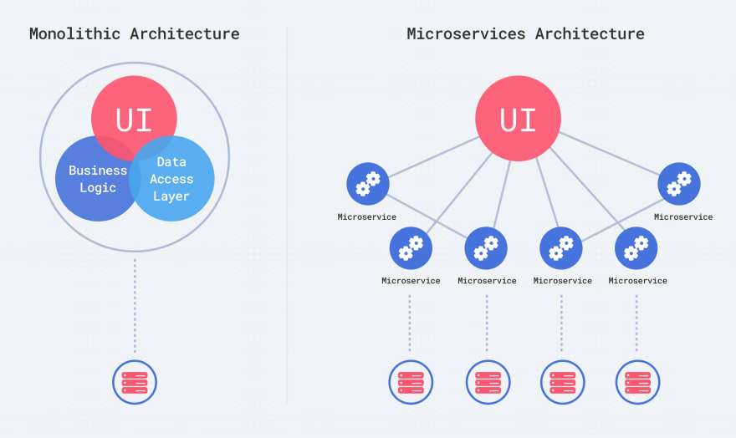
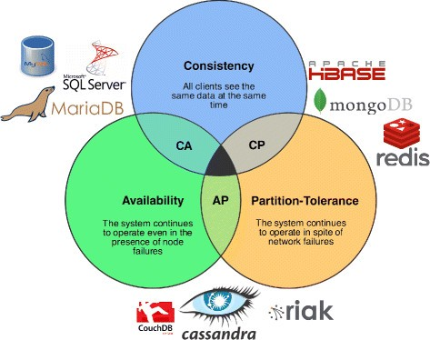
Microservices
Back in the day web services and applications were large, monolithic blobs.
With the introduction of containers, microservices started to emerge
Notes:
With microservices came a different way of thinking, I’m sure we have hear SOLID principles of Object-oriented design which cover
Single responsibility principle
open/close principal
substitution principle
interface segregation principle
Dependency inversion principle
Although some of the SOLID principles apply to microservices, object orientation is a design paradigm that deals with elements (classes, interfaces, hierarchies, etc.) that are fundamentally different from elements in distributed systems in general, and microservices in particular.
Interface segregation
deploy ability (it’s on you)
Event-driven
Availability over consistency
Loose coupling
Single Responsibility
Notice two of the are the same, the principles don’t cover the whole spectrum of design decisions for microservices-based solutions, but they touch the key concerns and success factors for creating modern service-based systems.
Not all the time but generally, microservice favor availability over consistency shown in the CAP theory photo on the right it’s kind of a pick two situation. Basically one micro service can go down and not cause a problem with others or as a model as goes down and it’s all down.

Slide 12
Microservices Vs Monolith
Microservices sound great but are not always the answer.
Microservices require more collaboration and well-defined contracts between microservices
Monitoring of the microservices is a MUST
Monoliths are usually easier to deploy (as there is just one), however, if there are well defined contracts that support BOTH backward and forward compatibility, microservices SHOULD be able to deployed on-demand at any time.
Notes:
Resume Aug 21st

Slide 13
Recap and Q&A
Tonight’s Objectives:
Have a high-level understanding of some topics not covered in LC101
Pique your interest ☺
Notes:
Hope fully something here piqued your interest! Again, this was not to make you a master in these things but it get a very high-level understanding of some words you might hear.

